Slide 1
What is Google up to with Android?

Slide 2
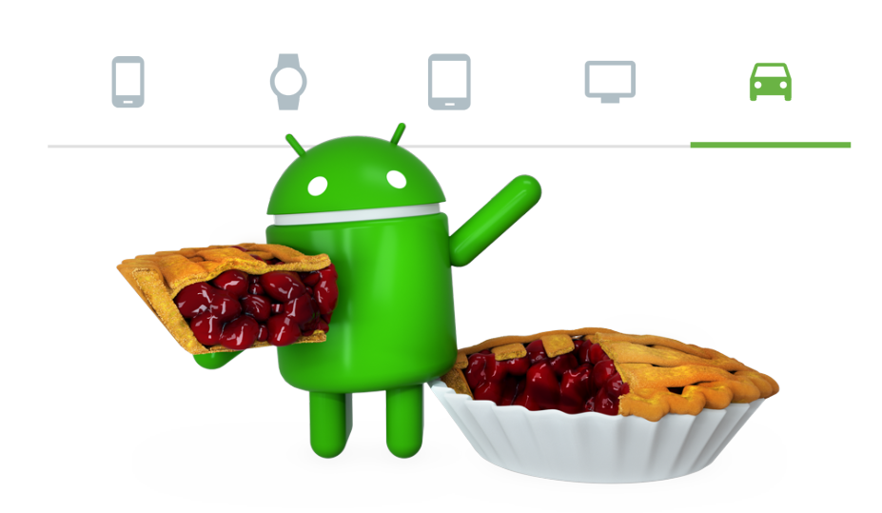
ARIoT | March 2019 | David Johansson

Slide 3

What google does good!
What Google is learning…
Appstore
Audio
Rear view
camera
Maps
Power
Assistant
ARIoT | March 2019 | David Johansson

Slide 4
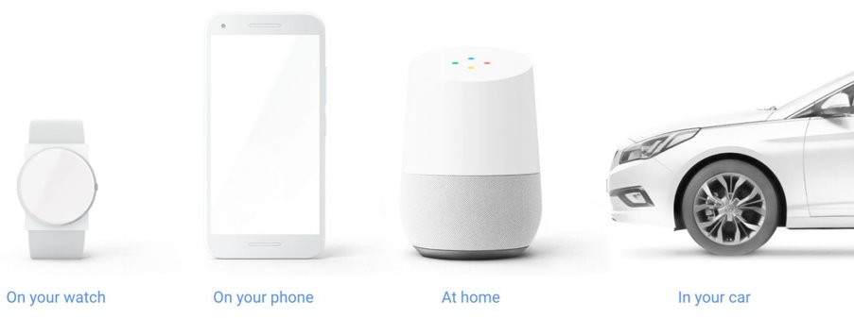
It is an Ecosystem...
ARIoT | March 2019 | David Johansson

Slide 5

Other ”Giants” are intersted
ARIoT | March 2019 | David Johansson

Slide 6
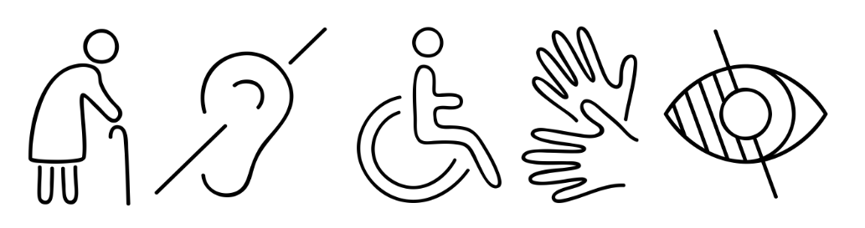
New users 15% of the world’s population has a disability
ARIoT | March 2019 | David Johansson

Slide 7
Rollout of new Android Desserts
Applications
Developers deliver daily in
Google Appstore
Android Framework
Google releases 2 desserts
a year
Hardware Support
Hardware manufactures have
a hardtime keeping up
ARIoT | March 2019 | David Johansson

Slide 8
But was has hardware with new Android functionality to do?
Applications
Compatibility tests
Android Framework
Android Q
Trebble
Android P
Hardware Support
ARIoT | March 2019 | David Johansson

Slide 9
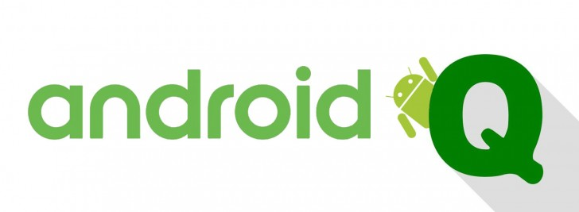
Quesadilla
Quiche
Quinoa
Quail
Quesito
Qurabiya
Quaker Oats
Quenelle
Quinoa Pudding
Google is expanding its Ecosystem.
Google are trying to reach new groups.
Google decreases their time to market.
But even though the code is open, it is not very transparent in their next releases.
ARIoT | March 2019 | David Johansson

